Slide 1
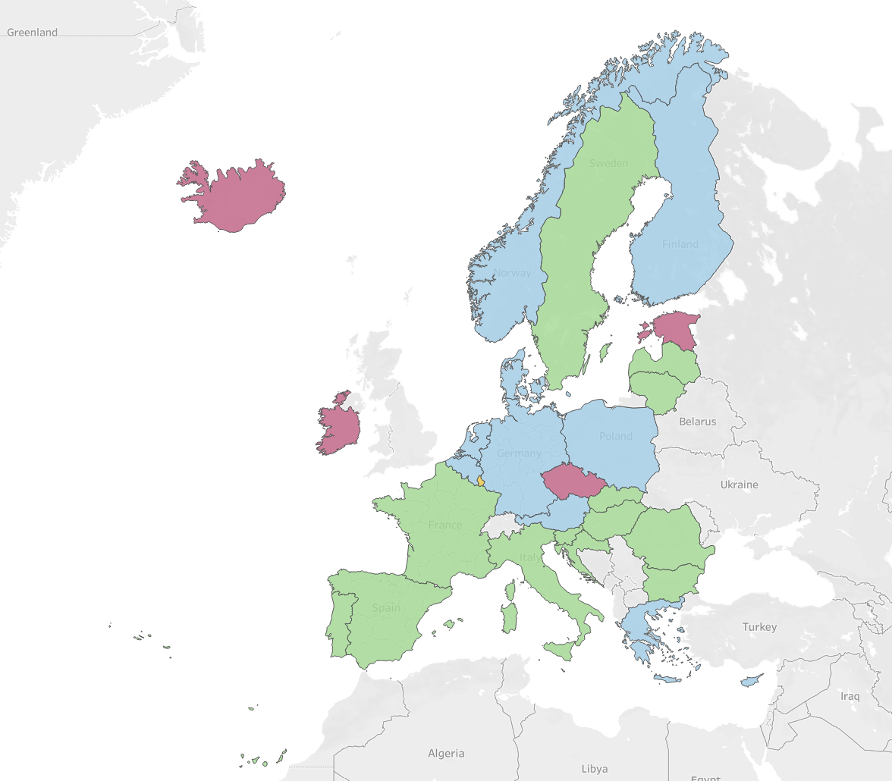
Data Visualization Pitch
Student Individual Assignment
Gradual reduction trend
Volatile trend
Steady decline trend
Outlier
European Emission Trend
1990-2023
Student name: Chiara Mezzanzanica
Student ID: 895530
Student e-mail address:
c.mezzanzanica2@campus.unimib.it

Slide 2
Research questions
1
2
Is Europe on track to meet the 2030 target of reducing total greenhouse gas emissions by 55% compared to 1990 levels?
- Have any European countries already
achieved this reduction target?
- Is the trend influenced by geopolitical and
economic events?
Is the level of per-capita emissions linked to the socio-economic structure of a country?
- How does the population influence the
emissions per capita?
- Which country currently has the highest
level of greenhouse gas emissions per
capita?

Slide 3
About Data
Dataset: “Domestic net greenhouse gas emissions” (https://ec.europa.eu/eurostat/cache/metadata/en/sdg_13_10_esmsip2.htm)
The dataset published by Eurostat is coherent, comprehensive, and supported by detailed metadata that clarify its methodological foundations. It’s selection was also motivated by the fact that many other emission datasets presented missing values or inconsistent structures due to non-standardized data collection methods across countries. The Eurostat dataset, instead, offers a reliable and harmonized time series, containing greenhouse gas emission data from 1990 to 2023 for the 27 EU countries, along with Norway and Iceland.
The dataset is shared under the Eurostat Licence Policy, which allows free reuse of the data without the need for explicit permission. The only requirement is to cite Eurostat as the data provider, which is fully compatible with the intended use of the dataset in my work.
Regarding data quality and completeness, the dataset follows high Eurostat quality standards, but some limitations still exist. Since the underlying data originate from UNFCCC reporting via the EEA the accuracy can vary between countries.
I did not find any missing values in the dataset. However, I performed a structural cleaning step by splitting the original file into four separate datasets, based on the measurement units used and on the different selection of categories in the Kyoto basket of greenhouse gases. This reorganization made it easier to work with internally consistent subsets of the data and facilitated subsequent analysis.

Slide 4
Methodology
The data were easily downloaded from the Eurostat website and processed in Python, using pandas for structural cleaning and the initial exploration. The analysis was carried out in parallel on two complementary datasets: one showing, for each country, the emission trends indexed to 1990 as the base year and another reporting greenhouse gas emissions per capita.
I began the analysis using descriptive statistics, correlation measures, and basic visualizations to gain an overall understanding of the dataset’s structure and behaviour. I then started the two analysis:
First dataset: Having noticed an interesting variability among the trends of different regions, I decided to use Matplotlib to create a visualization that highlighted both the average European trend and the extreme values reached by individual nations. I also chose to compare the anomalous points in the European average trend with a list of relevant socio-economic events to evaluate whether any correlation could be observed.
It was striking to see that, whereas some countries are already meeting the 55% reduction target for 2030 compared to 1990, others have moved in the opposite direction and have nearly doubled their emissions. To explore this further, I created a couple of rankings to identify which countries were on the best and worst track.
Second dataset: To better highlight the shifts in emission trends and their potential links to the economic structure, I applied a k-means clustering approach and then used Tableau to visualise the resulting groups. During this workflow, I also used Claude to assist in converting the country identifiers from the original dataset into a format compatible with Tableau, ensuring a smooth integration of the data into the visualization environment.
The analysis is fully reproducible, since all data used are publicly accessible and the python code is available at: https://github.com/mezza04/Data_Visualization_Project.

Slide 5
Insights
The indexed dataset tracks each country's emissions trajectory relative to their 1990 baseline.
Maximum overall: 179.40, Cyprus (2008)
Minimum overall: 27.00, Estonia (2023)
Average: 89.26
Highest Volatility: 20.24 Denmark
Lowest Volatility: 5.19 Norway
While the average reveals a reduction in emissions of around 10% across all countries, this aggregate figure masks a dramatic contrast between nations. Cyprus experienced the steepest increase, reaching nearly 80% above its 1990 levels by 2008, while Estonia achieved the most remarkable reduction, cutting emissions by over 70% by 2023. These extremes illustrate the vastly different environmental and economic paths taken by European nations over this period.
Equally revealing is the stability of these trends. Norway maintained the most consistent emissions pattern with minimal fluctuation, suggesting steady energy policies and economic structure. In contrast, Denmark exhibited the highest volatility, reflecting more dynamic shifts in its energy mix and industrial composition over the decades.
The per capita dataset adds another dimension to this analysis, the population’s fluctuations.
Maximum overall: 34.6, Luxembourg (1991)
Minimum overall: 4.0, Malta (2020)
Average: 10.31
Luxembourg recorded the highest per capita emissions at 34.6 tonnes in 1991, while Malta achieved the lowest point at just 4.0 tonnes per capita in 2020. The average across all countries and years stands at 10.31 tonnes per capita. These figures underscore not only the progress some nations have made but also the persistent disparities in emission intensity across the region, shaped by factors ranging from industrial structure to energy sources and population density.

Slide 6
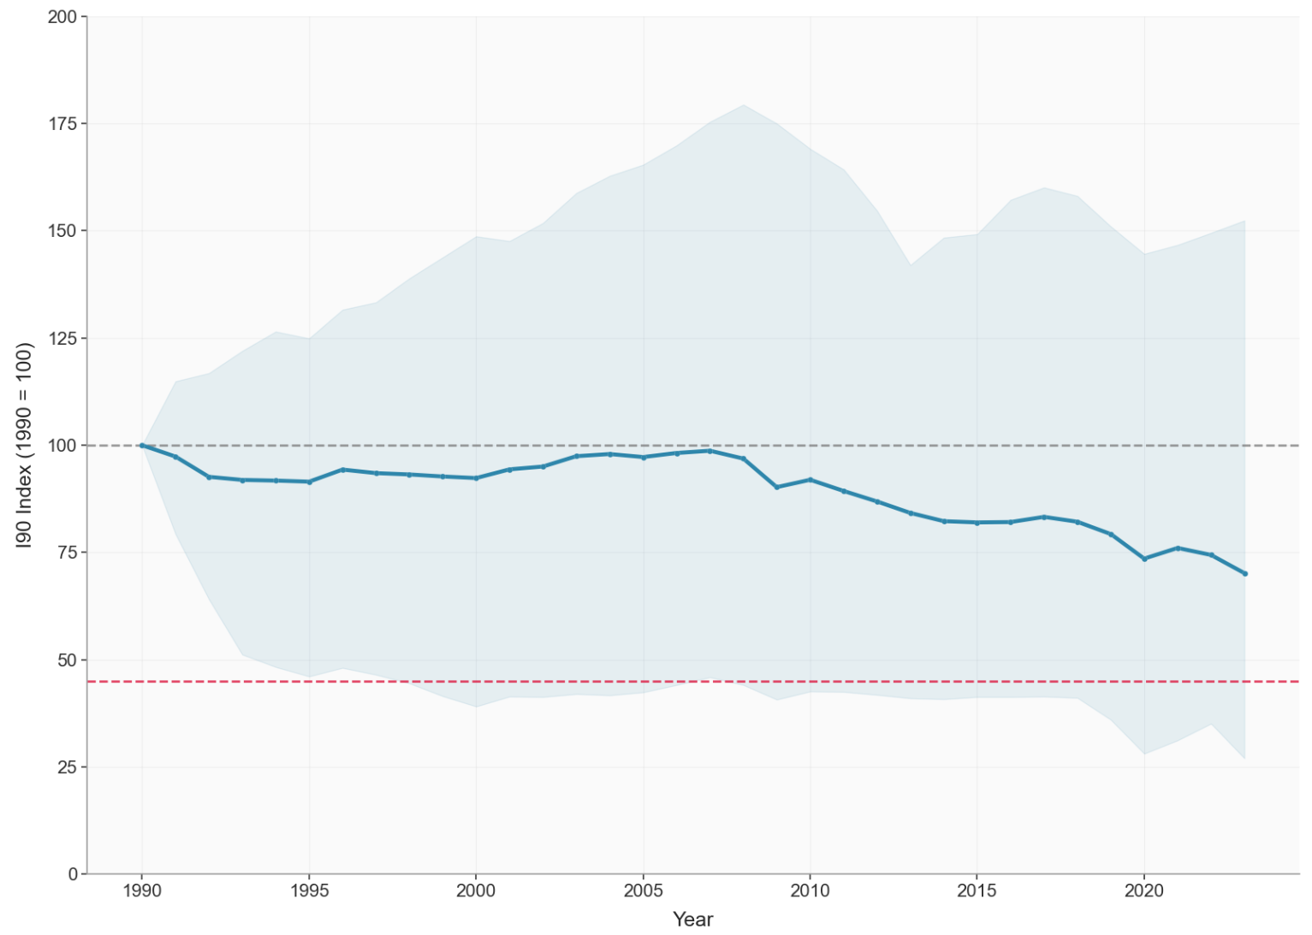
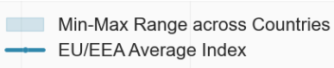
Emission 30% down since 1990: Europe’s climate journey toward 2030
The chart shows the trend of the EU/EEA Average Emissions Index since 1990, compared with the European climate goals: a 55% reduction by 2030 relative to 1990 levels and climate neutrality by 2050. The variability band highlights differences among countries, while the main line represents the European average.
A generally decreasing trend is visible, though influenced by geopolitical and economic events. In particular, the 2008 recession and the 2020 pandemic caused temporary drops in emissions due to the contraction of economic activity.
But this European average masks dramatic differences between nations—from climate leaders who've already exceeded targets to laggards still above 1990 levels.
1990 Baseline (Index = 100)
Recession
Pandemic
2030 Target: -55% (Index = 45)
Made with Matplotlib – Python

Slide 7
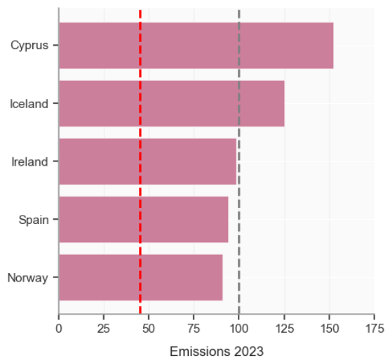

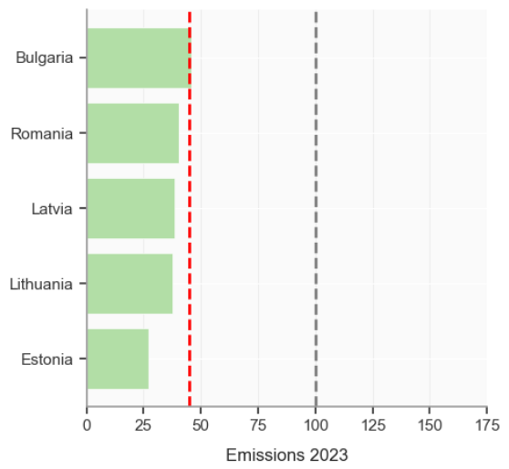
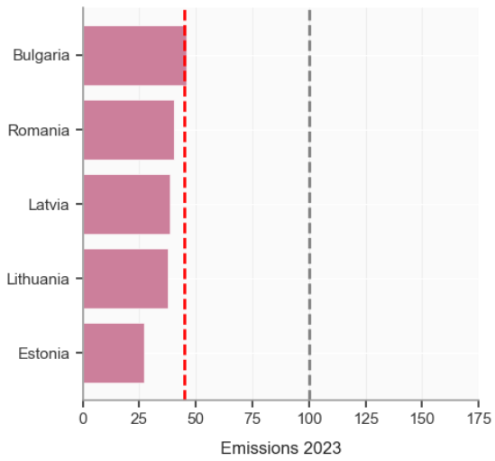
Worst Emission index in 2023
Is Europe on track to meet the 2030 target of reducing total greenhouse gas emissions by 55% compared to 1990 levels?
In 2023, only two countries - Cyprus and Iceland - record greenhouse gas emission levels that are higher than their 1990 values. This indicates that, unlike the rest of Europe, these countries have not yet begun a sustained downward trajectory in total emissions, and in fact show a long-term growth trend.
By contrast, four countries—Romania, Latvia, Lithuania, and Estonia—have already surpassed the 2030 target of reducing emissions by 55% compared to 1990. These nations stand out as clear leaders in decarbonization, having achieved significant structural shifts in their energy systems, industrial profiles, or demographic patterns that have contributed to deep reductions in emissions.
The remaining countries fall within a broad intermediate band, this suggests a fairly even distribution: while several countries are approaching the target, many still display only moderate progress, and a few remain considerably above the desired trajectory.
Given that only seven years remain until 2030, the window for corrective action is narrowing. If the current reduction trends persist without substantial acceleration, the European average index is unlikely to reach 45, the threshold corresponding to the required 55% reduction. Meeting the target will therefore require intensified efforts, including stronger policy measures, accelerated deployment of renewable energy, improved energy efficiency, and deeper structural transitions in high-emission sectors.
Best Emission index in 2023
Made with Matplotlib – Python

Slide 8
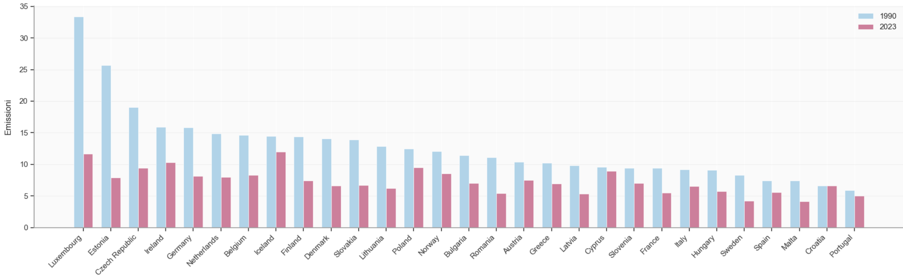
Beyond averages: the demographic factor in Europe’s climate story
The graph shows a significant reductions in per capita emissions across all European countries between 1990 and 2023, but this data must be interpreted considering demographic variations. Per capita emissions represent the ratio between total emissions and population. Demographic decline amplifies per capita reductions even with moderate decreases in absolute emissions, while population growth can mask real progress in decarbonization.
Countries like Germany, France, and Italy, with stable populations, show moderate reductions that more faithfully reflect real decarbonization progress. Luxembourg, despite reducing from 33 to 11 tonnes per capita (-65%), experienced strong demographic growth (+80%), meaning the reduction in absolute emissions was even more substantial than it appears.
Made with Matplotlib – Python

Slide 9
Is the level of per-capita emissions linked to the socio-economic structure of a country?
By analyzing the decarbonization pathways based on per-capita emissions, EU/EEA countries can be grouped into four clusters, each showing distinct patterns and trajectories.
Countries with more developed and energy-intensive industrial sectors, such as Germany and Austria, show a more gradual reductions over time due to the structural weight of manufacturing, heavy industry and transport within their economies.
Countries that have achieved moderate but steady declines, often driven by improvements in energy efficiency, diversification of energy sources or shifts toward services (e.g., France, Italy, Croatia, Portugal).
Countries with sharper or more volatile emission trajectories, often influenced by smaller economies, specific energy mixes, or rapid structural changes, such as Estonia, Ireland or Iceland.
Luxembourg stands out as an outlier, forming its own cluster: its unusually high per-capita emissions, strongly influenced by cross-border fuel sales and the small size of its economy, make its trend markedly different from all other countries.
Made with Tableau

Slide 10
LICENCE
Slides are shared with the following license:
"EUROPEAN EMISSION TREND 1990-2023" by CHIARA MEZZANZANICA, is licensed under a CC BY-NC 4.0

